Slide 1
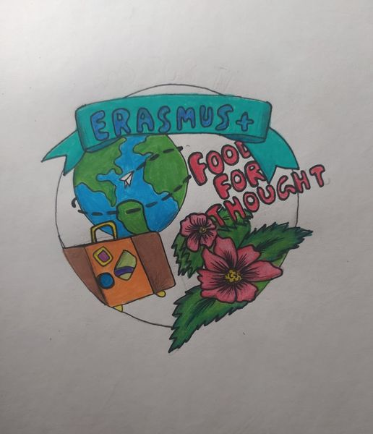
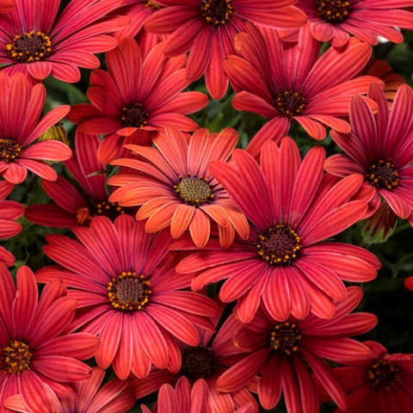
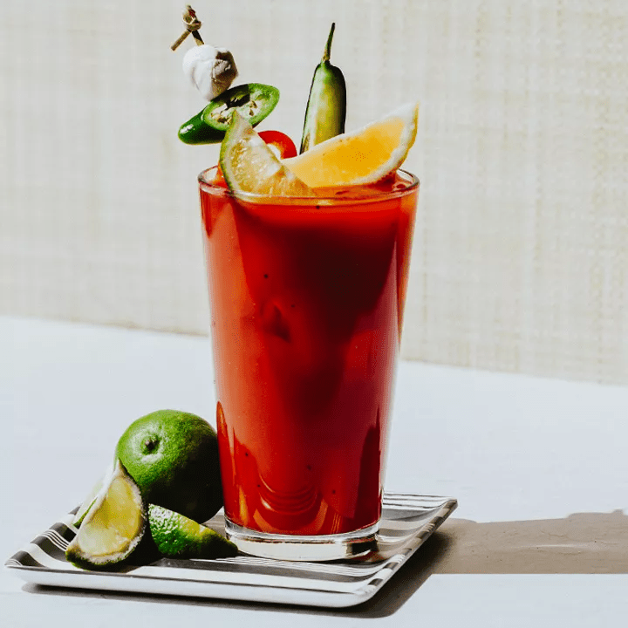
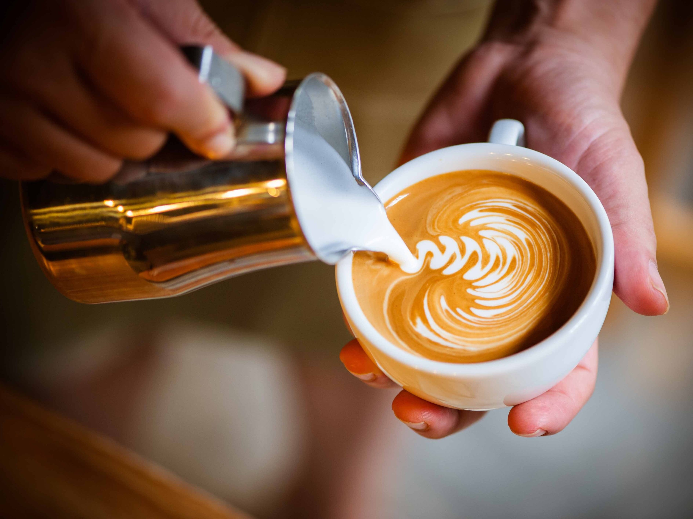
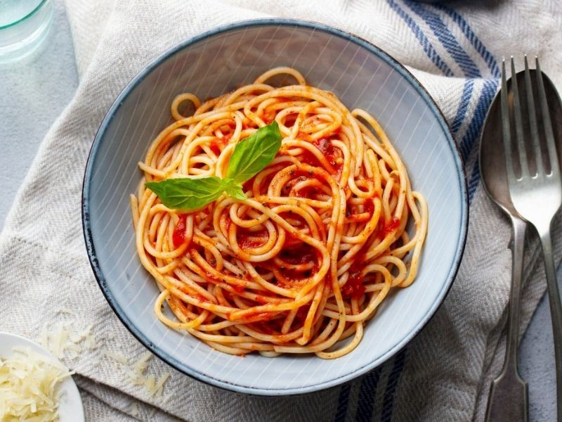
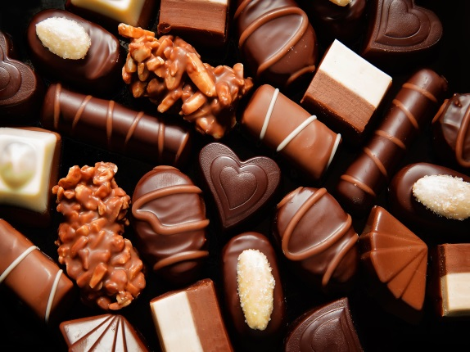
ARTISTS WHO USE FOOD AS MATERIAL AND THEME IN THEIR ART WORKS

Slide 2
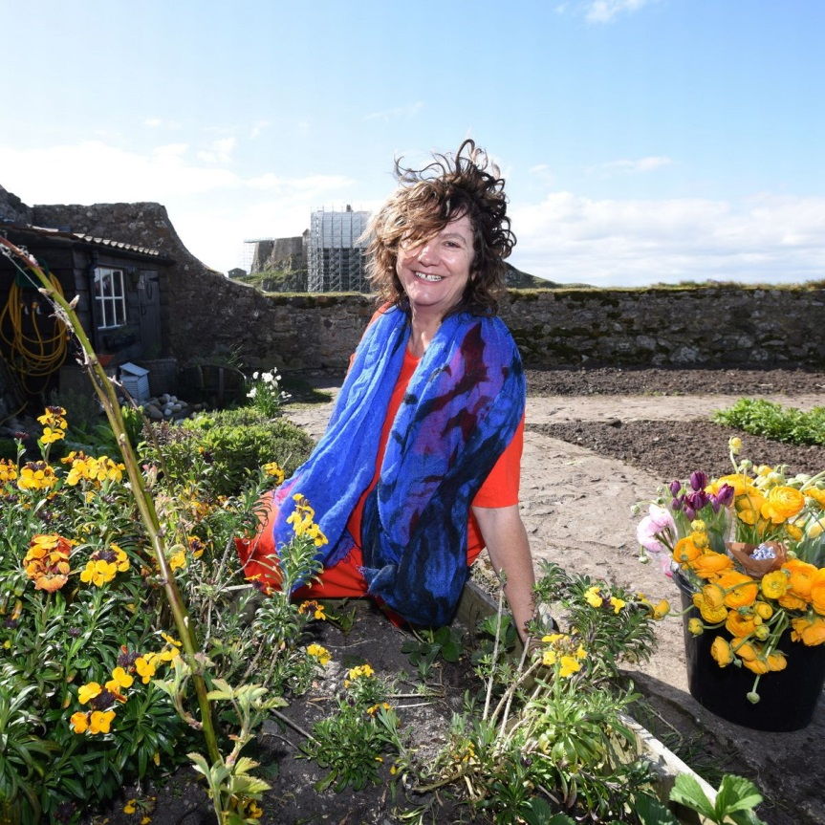
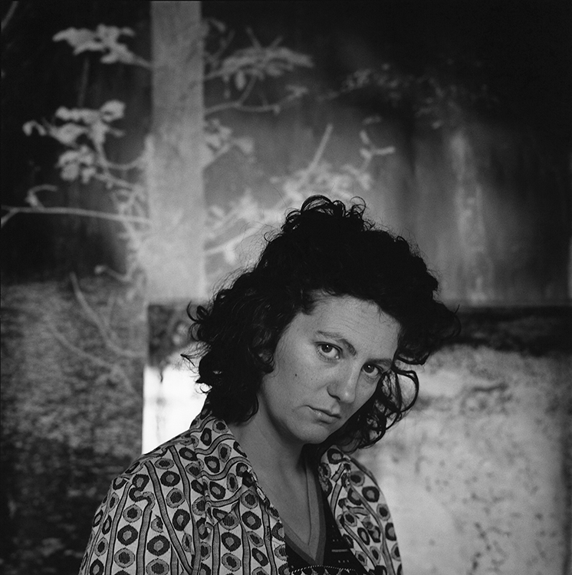
ANYA GALLACCIO
Was born in 1963 and is a British artist, who creates site-specific, minimalist installations and often works with organic matter (including chocolate, sugar, flowers and ice).

Slide 3
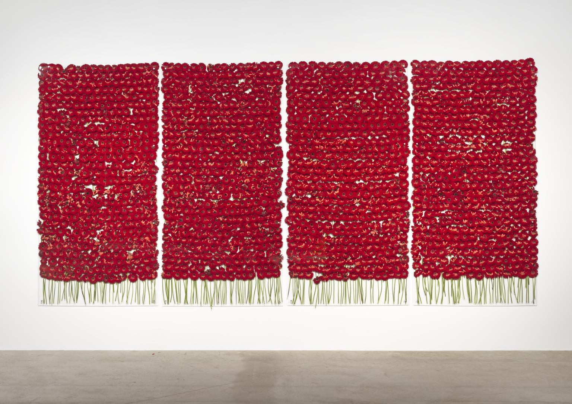
PRESERVE BEAUTY
The work was made in 1991 for an installation in the window of Karsten Schubert gallery in London.
Gallaccio used eight hundred flowers
The type of flower used in the installation is a hybrid between a gerbera and a daisy.

Slide 4
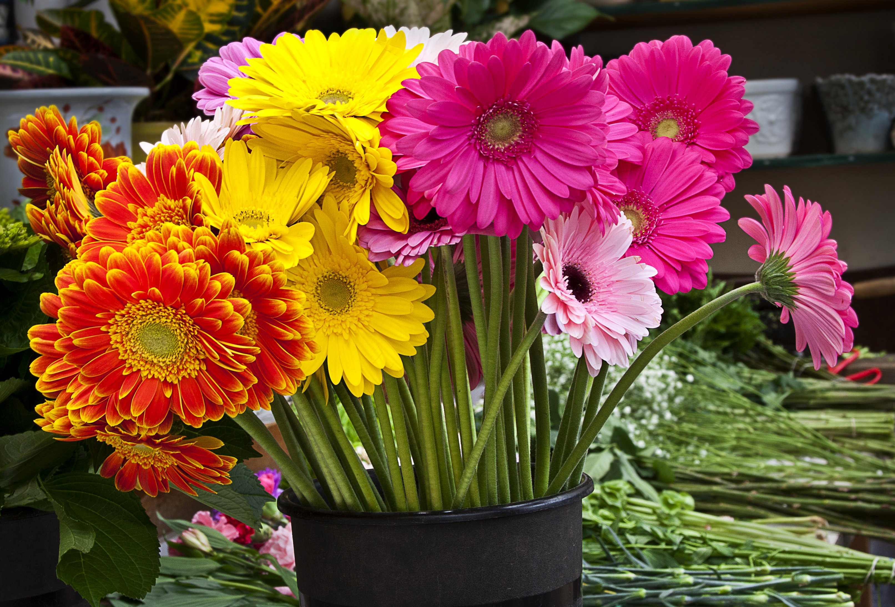
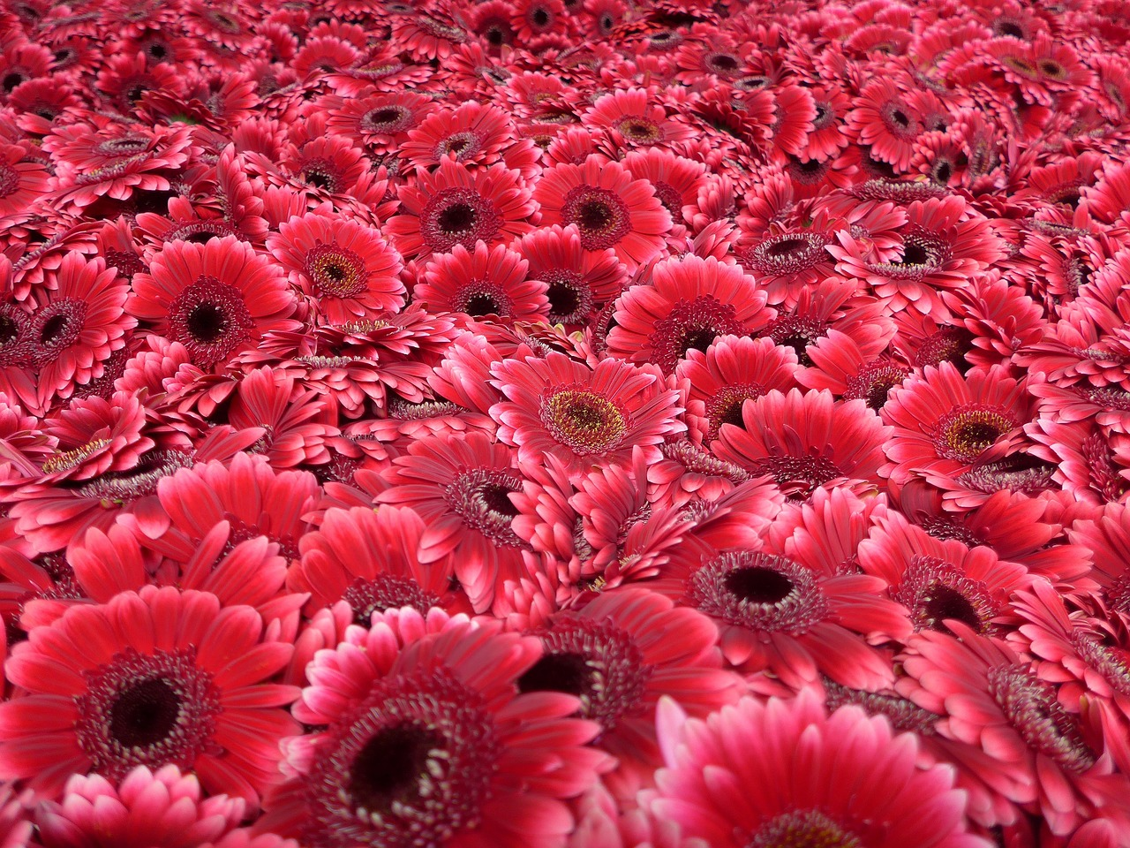
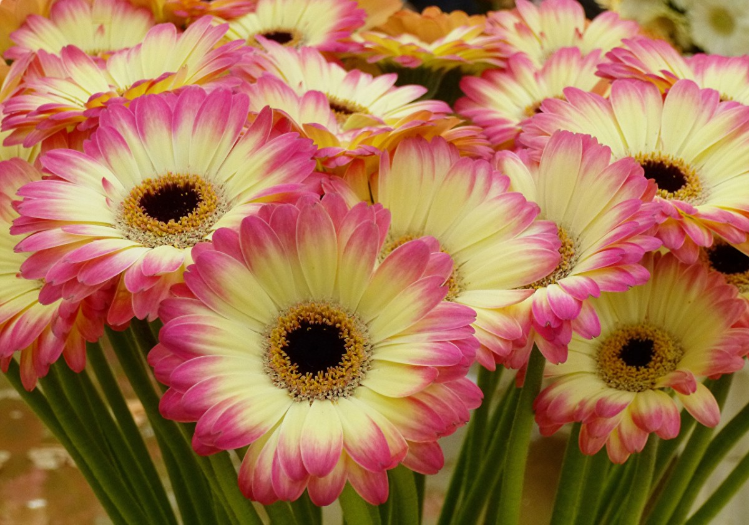

Slide 6
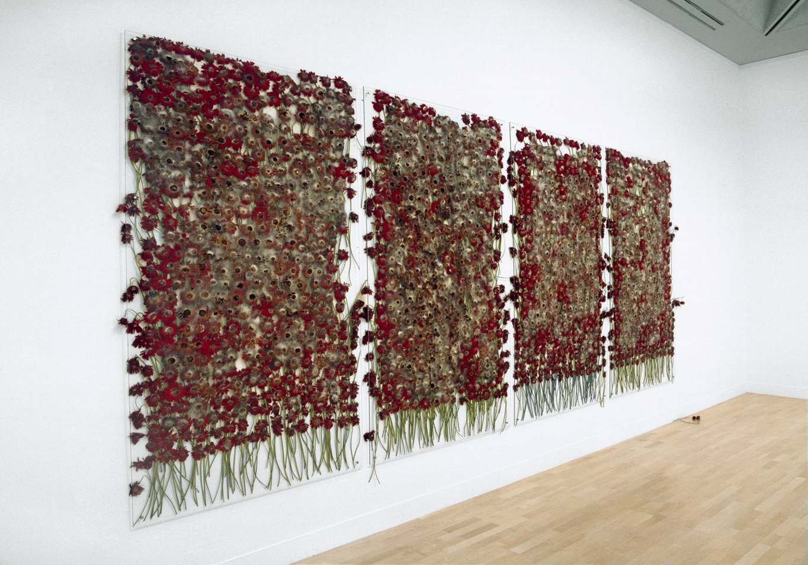
DAISIES ROT JUST LIKE BEAUTY
This installation challenges romantic ideas associated with flowers and our relationship to nature.

Slide 7
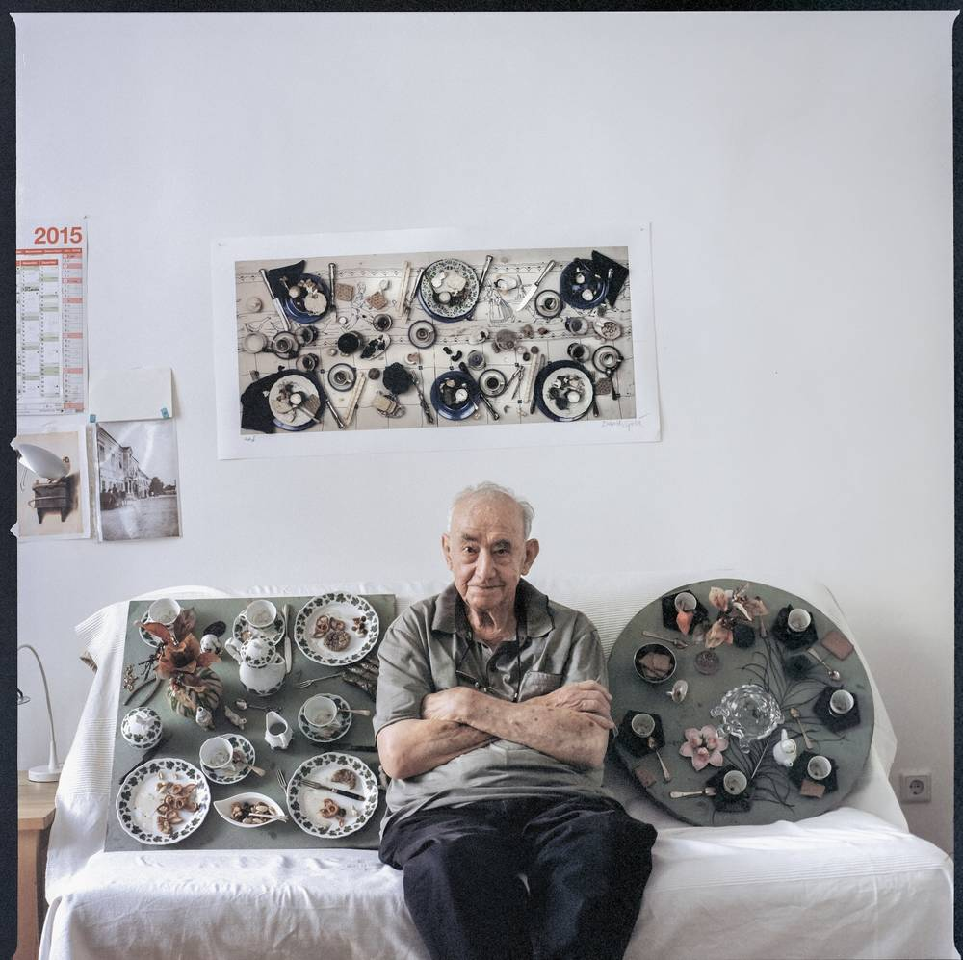
DANIEL SPOERRİ
Swiss artist born in 1930
He is regarded as the inventor of the eat art.
He opened the restaurant ‘Spoerri’ and ‘the eat art gallery’ in Düsseldorf in 1968.

Slide 8
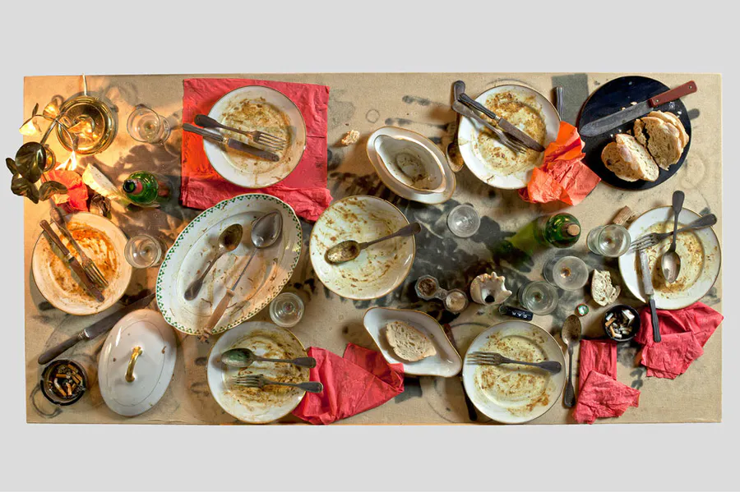
FROZEN DINNERS

Slide 9
SONJA ALHAUSER
German artist born in 1969.
She is represented by; Micheal Schulz Gallery.

Slide 10
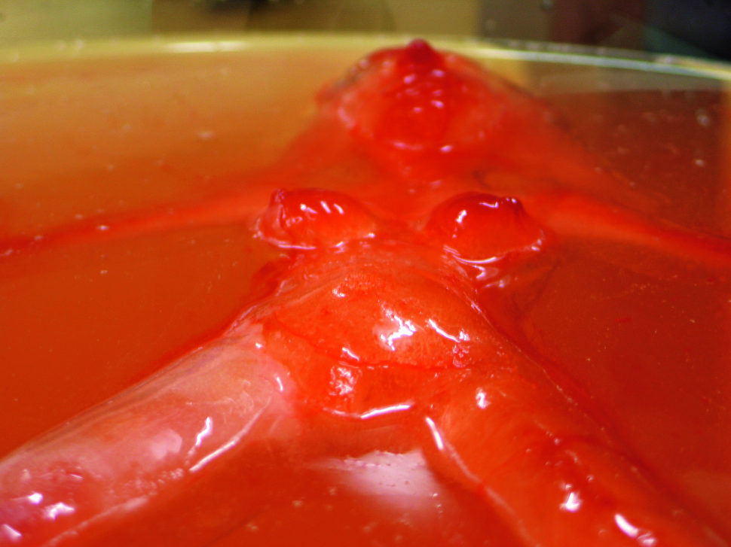
BLOODY MARY
HOPE THEY DON’T TURN INTO A VAMPIRE ☺

Slide 11
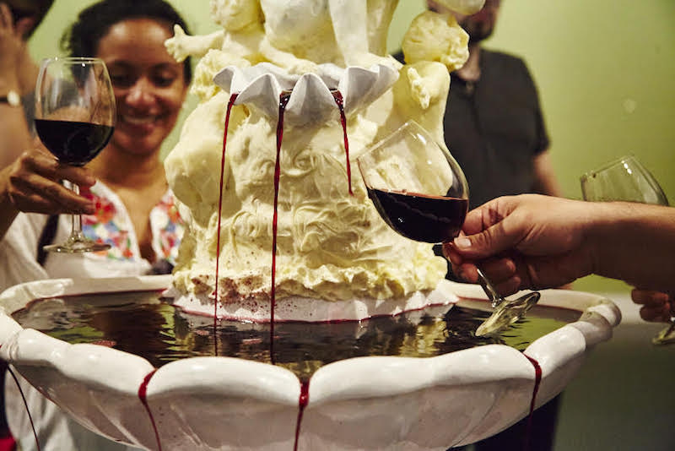
ARTWORKS CAN BE EATEN BY THE VISIToRS

Slide 12
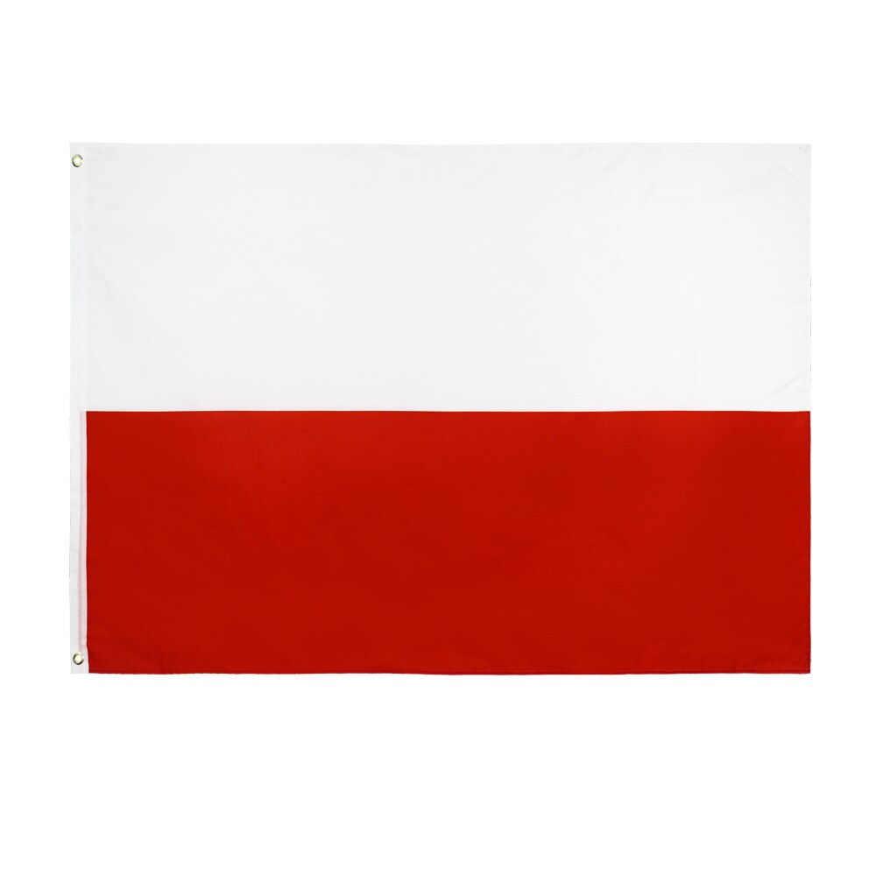
THANK YOU FOR LISTENING!
NÓS AGRADECEMOS!
ΣΑΣ ΕΥΧΑΡΙΣΤΟΥΜΕ!
DZIĘKUJEMY!
TEŞEKKÜRLER!
DURU GÜNDOĞAN
ASYA MEY ÜTE

